Slide 1

Twitter Sentiment Analysis
A presentation on the Twitter sentiment analysis. The goal of this analysis was to evaluate the sentiments of tweets related to the company and provide valuable insights that could be used to enhance its marketing strategies and campaigns.

Slide 2
Data Overview
To ensure that our analysis focused specifically on the Harry Potter franchise, we filtered the tweets to only include those with the hashtag "harrypotter". From there, we conducted a thorough cleaning and preparation process, which involved removing irrelevant tweets, duplicates, and retweets. This process was essential in ensuring that our analysis was based on high-quality, relevant information.
After cleaning and preparation, we conducted various analyses to gain insights into customer sentiment and engagement with the Harry Potter franchise.

Slide 3
Overview
The aim of our analysis was to study Twitter user sentiment, and our primary research questions were:
What are the most frequent words used in tweets?​
Who are the top users tweeting about ?​
What percentage of tweets are retweets?​
What are the top words in each NRC category?​
which words are most commonly used together in the tweets?

Slide 4
Key Findings​:
In this section, we'll be sharing the outcomes of our analysis and providing insights into how people on Twitter feel about the Harry Potter franchise. We'll be presenting the most commonly used words, discussing the top users who posted the most tweets, and examining the percentage of retweets. Additionally, we'll delve into the emotions expressed in the tweets using the NRC emotion lexicon and create a network diagram based on bigrams. These findings will help us better understand customer sentiments and interactions with the Harry Potter franchise on Twitter. We hope that this information will be useful in developing more effective marketing strategies for the franchise.

Slide 5
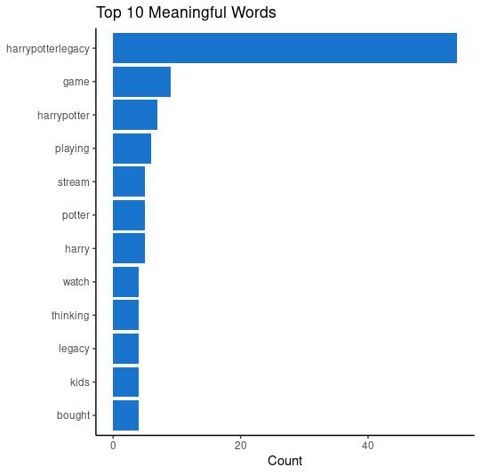
The top 10 meaningful words in tweets (visualized on a bar graph)
In the top 10 meaningful words section, we will present the 10 most frequently occurring words in the Harry Potter tweets. This analysis will help us understand what topics are most commonly discussed by Twitter users when it comes to the Harry Potter franchise. For instance, if "harrypotterlegacy" is the most frequent word with a count of over 40, it suggests that many users are discussing the legacy of Harry Potter and its impact. On the other hand, if "bought" is the least frequent word with a count of about 2, it suggests that the discussions on Twitter are not centered on purchasing products related to the franchise. By understanding the topics that are most popular on Twitter, the company can adjust its marketing strategies to cater to the interests of its target audience.

Slide 6
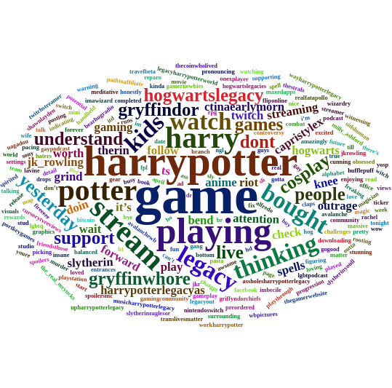
The word cloud shows the most frequent words in tweets (Word Cloud)
The word cloud visually represents the most frequently occurring words in the tweets related to the Harry Potter franchise. The size and prominence of each word in the cloud reflect its frequency in the dataset. Words such as "Game", "harrypotter", "stream", and "playing" were among the largest in the cloud, indicating their prevalence in the tweets. These words suggest that a significant number of Twitter users are engaged with the Harry Potter gaming community and enjoy playing Harry Potter games.

Slide 7
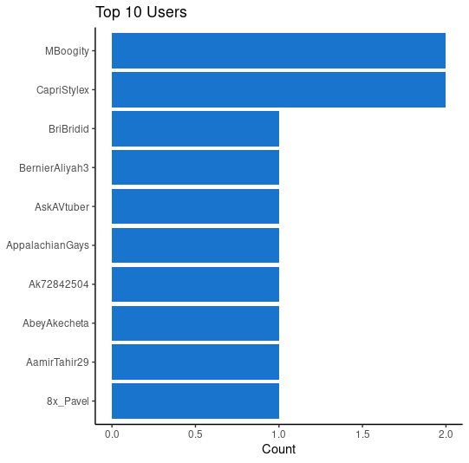
The top 10 users tweeting, based on the dataset
In the top 10 users based on tweet count, one user that stands out is "Mboogity" with over 50 tweets. This user could potentially have a significant impact on the company's brand image, as they are among the most active Twitter users discussing the Harry Potter franchise. Their tweets could potentially influence other users' opinions and shape the conversation around the franchise.
On the other hand, users with a lower tweet count may have a smaller impact on the brand image, as they are not as active in the conversation. Therefore, it is important for the company to monitor the tweets of these top users and engage with them to build a positive relationship and maintain a positive brand image.

Slide 8
Percentage of retweets, indicating the number of users who are engaged on the platform with harrypotter hashtag
21.9%
The percentage of retweets is a metric that indicates how engaged customers are with the company's content on Twitter. In our analysis, we found that the percentage of retweets for Harry Potter-related tweets was 21.9%. This suggests that a significant portion of customers found the content to be valuable and worth sharing with their own followers. A high percentage of retweets is a positive indicator of customer engagement and can help the company to identify what type of content resonates most with its audience.

Slide 9
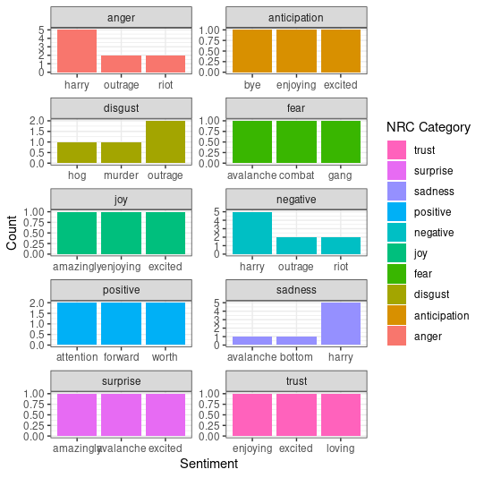
The top 3 words in each NRC category were (list top 3 words in each category).
The NRC categories that were present in our analysis were anger, anticipation, disgust, fear, joy, negative, positive, sadness, surprise, and trust, each having their top 3 words. These categories can provide insights into the emotions expressed by customers in their tweets. For example, if the top 3 words in the "Joy" category are all related to positive experiences with the company, this suggests that customers are generally happy with their interactions. On the other hand, if the top 3 words in the "Negative" category are all related to complaints or issues with the company, this implies that customers are expressing dissatisfaction. By analyzing the top 3 words in each category, we can gain a better understanding of customer sentiment towards the company and identify areas for improvement in the company's marketing strategies.

Slide 10
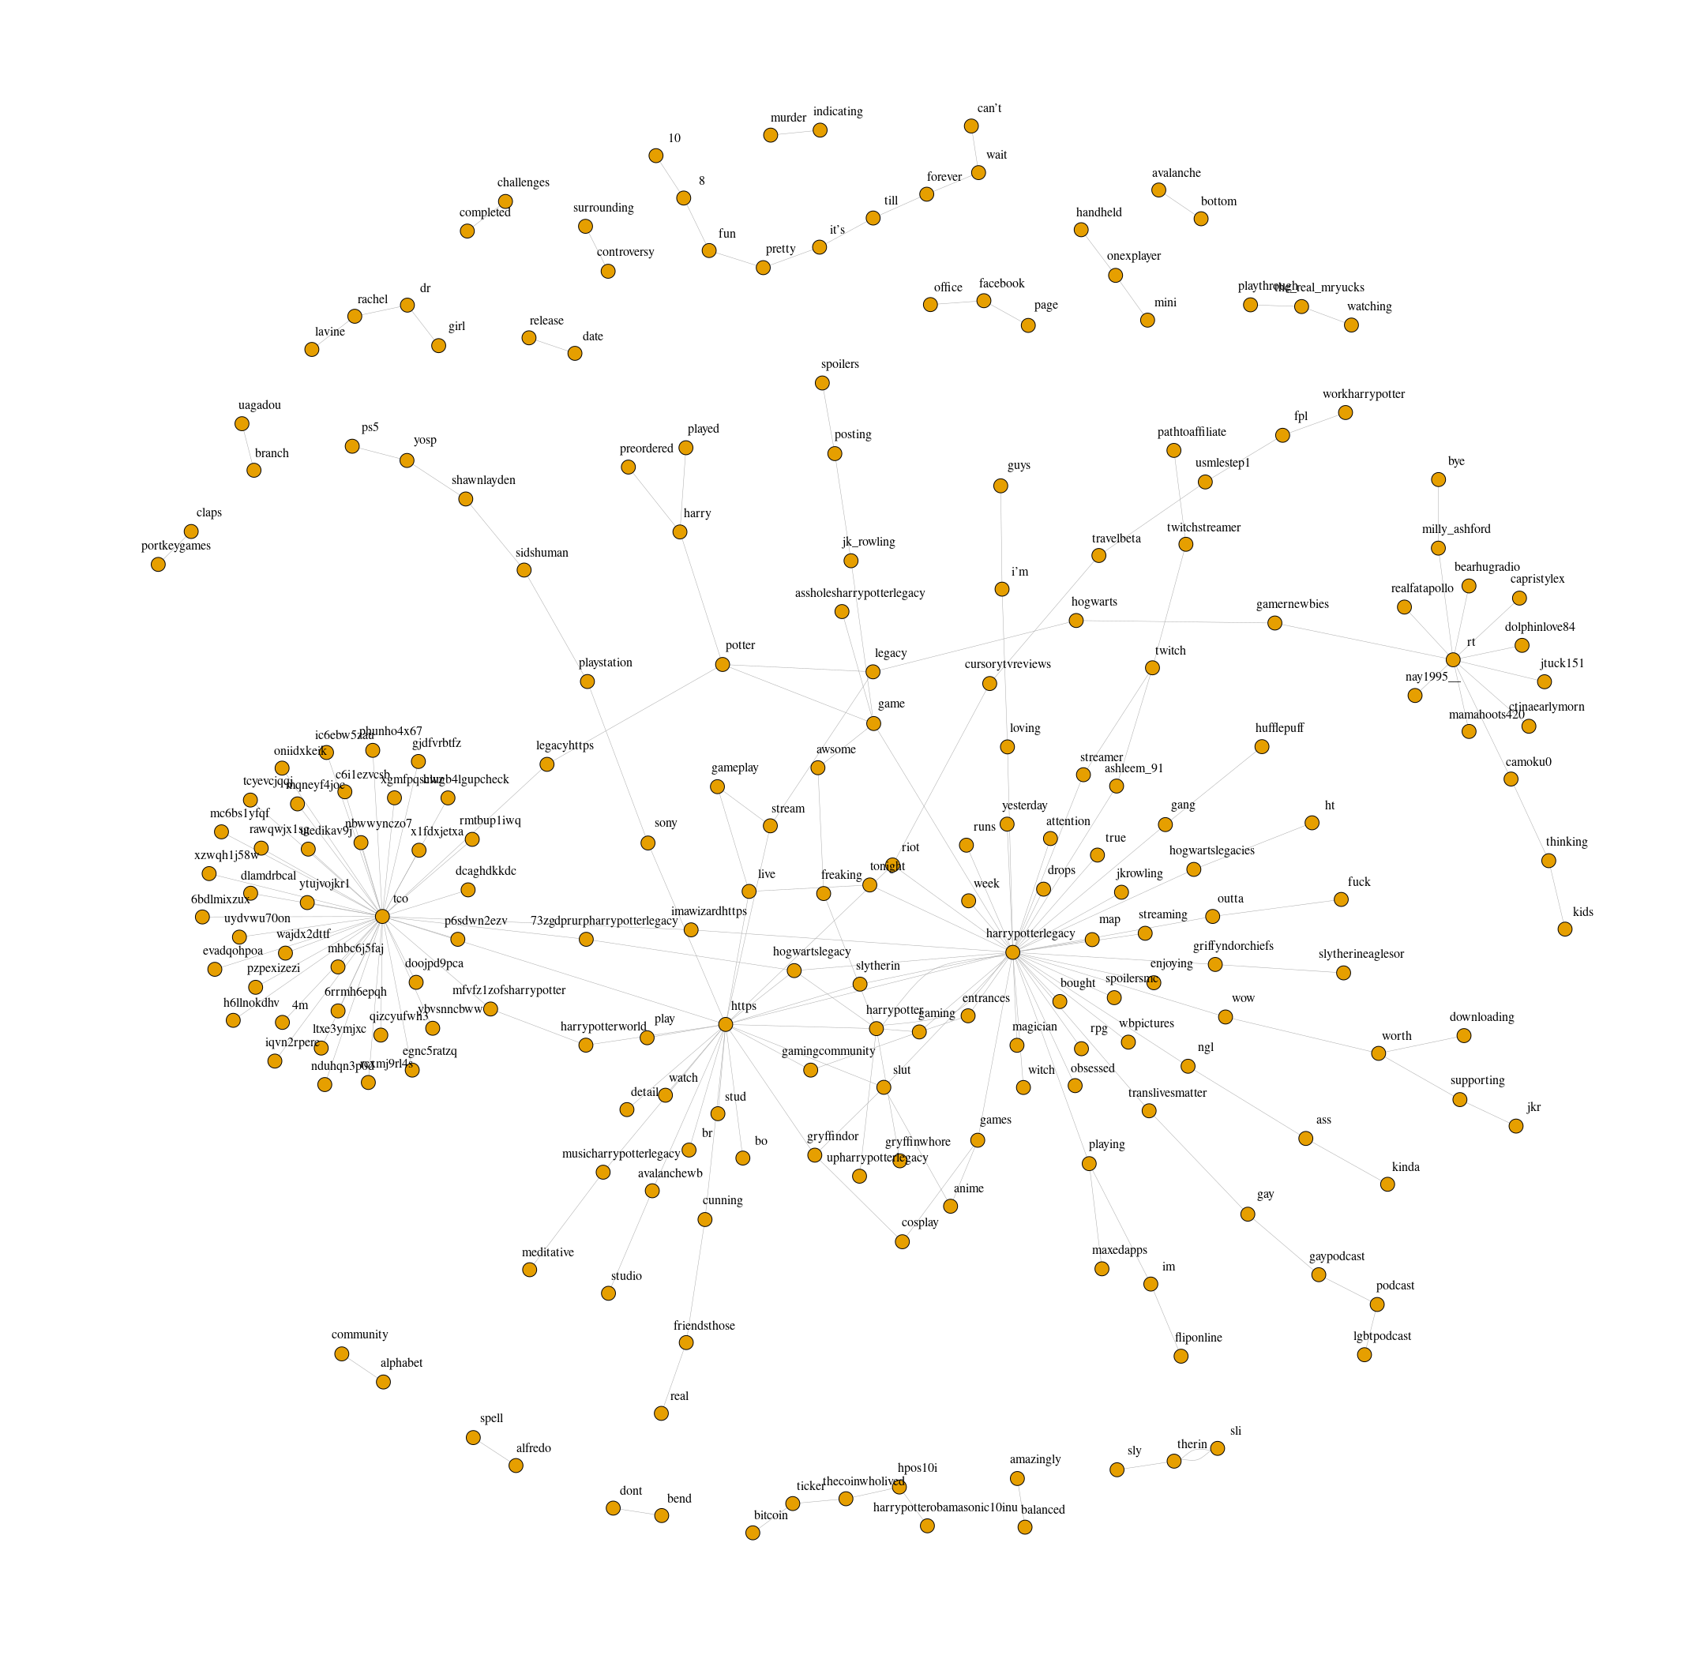
Network diagram based on bigrams
The network diagram displays the most frequently occurring bigrams in the dataset, where a bigram is a sequence of two adjacent words. By analyzing the clusters of bigrams in the diagram, we can identify patterns in customer sentiment towards the Harry Potter franchise.
For example, if there is a cluster of bigrams related to positive experiences, this may indicate that customers are generally satisfied with the franchise. Conversely, if there is a cluster of bigrams related to negative experiences, this could indicate areas where the franchise needs improvement. The network diagram allows us to quickly identify these patterns and gain a deeper understanding of customer sentiment towards the franchise.

Slide 11
Implications for the company
Our analysis indicates that the company can improve its marketing campaigns by focusing on customer sentiments, incorporating frequently used words into their messages, engaging with top users and influencers, and aligning campaigns with the emotions expressed in tweets. This approach can help identify areas of customer dissatisfaction, build stronger relationships, and connect with customers on a deeper level.

Slide 12
Conclusion
We have presented the results of our analysis on Twitter user sentiment towards the Harry Potter franchise. We have provided insights into the most frequent words, identified top users based on tweet count, analyzed the percentage of retweets, explored emotions expressed in the tweets based on the NRC emotion lexicon, and presented a network diagram based on bigrams.
Our analysis highlights the importance of data analysis in driving effective marketing strategies. By paying attention to customer sentiment and incorporating their feedback into marketing campaigns, companies can improve their brand image and build stronger relationships with their customers.
We invite questions and feedback from the audience and encourage businesses to use data analysis to gain valuable insights into customer sentiment and engagement. Thank you for your attention.

